Slide 1
COVID-19’s impact on the brain
Presented by Yujia Zhang
USC Mark and Mary Stevens Neuroimaging and Informatics Institute
USC Laboratory of Neuroimaging
loni.usc.edu

Slide 2
Coronavirus Pandemic Has Changed Our Lives
Mental health challenges:
Many teens show sign of anxiety and depression
Restrictions of the pandemic: more time isolated from friends, canceling of important social activities, such as sports and graduation.
Staying Healthy During the Pandemic:
More time outdoors or experience nature
Encourage better sleep habits
Keeping communication open while still giving space
Trying a web-based program
https://www.healthline.com/health-news/impact-of-covid-19-lockdown-on-teens-mental-health#How-to-help-anxiety-and-depression-in-teens-during-the-pandemic
USC Mark and Mary Stevens Neuroimaging and Informatics Institute
USC Laboratory of Neuroimaging
loni.usc.edu

Slide 3
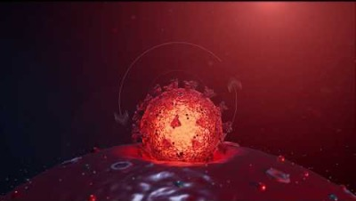
Understanding Coronavirus
COVID-19 $≠$ Flu
Spike protein/Angiotensin-converting enzyme 2 (ACE2)-dependent
https://genome.ucsc.edu/cgi-bin/hgTracks?db=hg38&lastVirtModeType=default&lastVirtModeExtraState=&virtModeType=default&virtMode=0&nonVirtPosition=&position=chrX%3A15560138%2D15602945&hgsid=999532331_w7X8ZCuyabaoaFKFSoyanTQOvDyG
Notes:
Studies have found a strong association between a locus on a specific gene cluster on chromosome three (chr3p21.31) and outcome severity, such as respiratory failure.
Cellular models have suggested an explanation for blood type modulation of infection, evidencing that spike protein/Angiotensin-converting enzyme 2 (ACE2)-dependent adhesion to ACE2-expressing cell lines was specifically inhibited by monoclonal or natural human anti-A antibodies, so individuals with non-A blood types, specifically O or B blood types, which produce anti-A antibodies, may be less susceptible to severe acute respiratory syndrome coronavirus 2 (SARS-CoV-2) infection due to the inhibitory effects of anti-A antibodies.

Slide 4
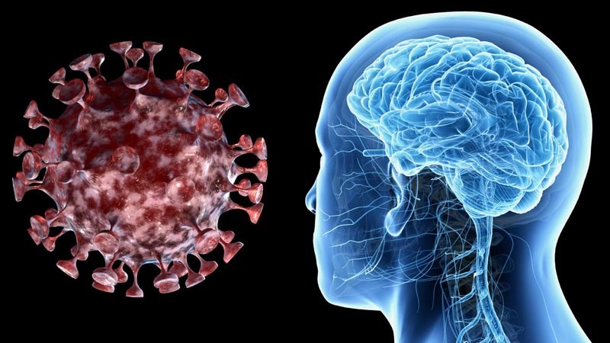
How virus enters the brain
Our brains are highly protected, so scientists are not entirely sure how virus enters the brain.
One hypothesis: the invasion happens at nose cells, then from there into a region at the front of brain.
The virus causes inflammation of the brain.
https://yourlocalepidemiologist.substack.com/p/covid19s-impact-on-the-brain?fbclid=IwAR06hfT4j58VS1aOPtDxtL8br9vuCTP4F0fCnE1uSEEwxnoGZIEgqHA6I20
USC Mark and Mary Stevens Neuroimaging and Informatics Institute
USC Laboratory of Neuroimaging
loni.usc.edu

Slide 5
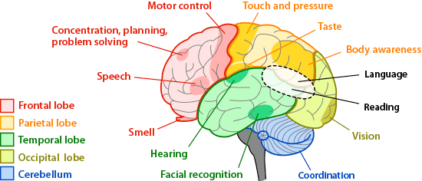
Neurologic Symptoms
COVID-19 brain fog: struggling for words, simple math, or having a hard time thinking clearly.
Loss of smell and taste
Headache
Dizziness
https://yourlocalepidemiologist.substack.com/p/covid19s-impact-on-the-brain?fbclid=IwAR06hfT4j58VS1aOPtDxtL8br9vuCTP4F0fCnE1uSEEwxnoGZIEgqHA6I20
USC Mark and Mary Stevens Neuroimaging and Informatics Institute
USC Laboratory of Neuroimaging
loni.usc.edu

Slide 6
Things can help to improve:
Perform aerobic exercise: start slow, perhaps just two to three minutes a few times a day.
Eat Mediterranean-style meals. A healthy diet including olive oil, fruits and vegetables, nuts and beans, and whole grains can help to improve thinking, memory and brain health.
Sleep well. Sleep is a time when the brain and body can clear out toxins and work toward healing.
Participate in social activities. Social activities benefit our moods and help our thinking and memory.
Pursue other beneficial activities: such as listening to music; practicing mindfulness; and keeping a positive mental attitude.
https://www.health.harvard.edu/blog/what-is-covid-19-brain-fog-and-how-can-you-clear-it-2021030822076
USC Mark and Mary Stevens Neuroimaging and Informatics Institute
USC Laboratory of Neuroimaging
loni.usc.edu

Slide 7
Thank you, Laboratory of Neuro Imaging (LONI), for this great opportunity!
This work was supported by the National Science Foundation under Award Number 2027456 (COVID-ARC)

